Slide 1
TensorFlow

Slide 2
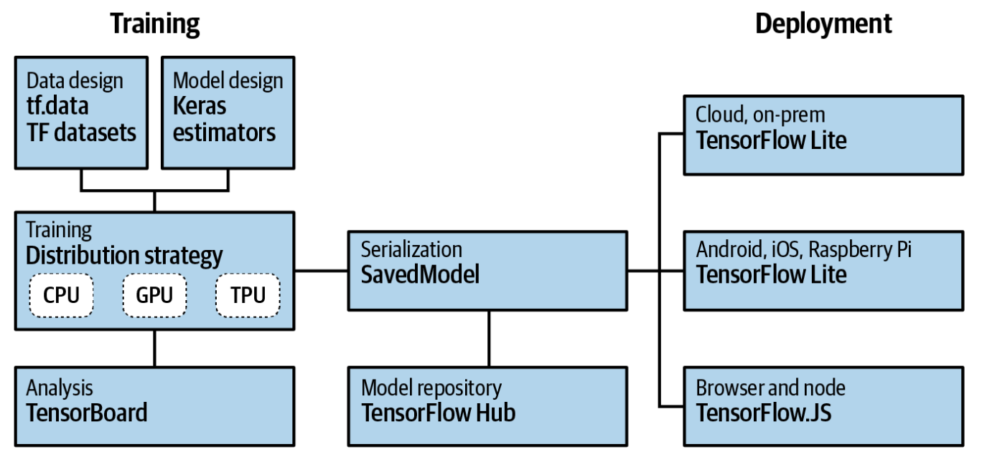
What is TensorFlow?
Notes:
TensorFlow is an open source platform for creating and using machine learning models. It implements many of the common algorithms and patterns needed for machine learning, saving you from needing to learn all the underlying math and logic and enabling you to just to focus on your scenario.
It’s aimed at everyone from hobbyists, to professional developers, to researchers pushing the boundaries of artificial intelligence.
We will heavily rely on Keras, a high-level API that allows you to encapsulate common machine learning paradigms in code.

Slide 3
Using TensorFlow
Installing TensorFlow in Python
Using TensorFlow in PyCharm
Using TensorFlow in Google Colab

Slide 4
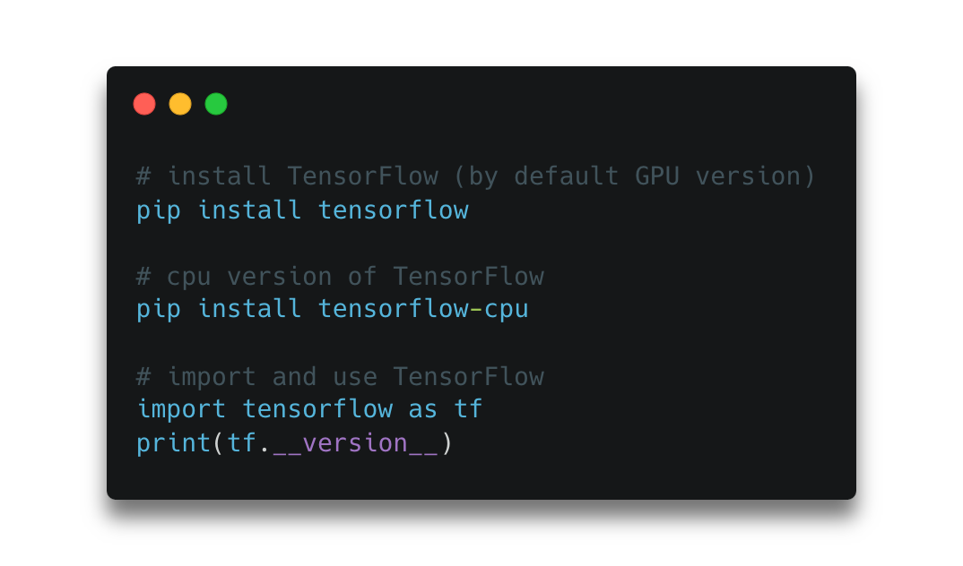
Installing TensorFlow in Python
Notes:
Assuming Python 3.x is installed in the machine.
Note that starting with version 2.1, this will install the GPU version of TensorFlow by default. Prior to that, it used the CPU version. So, before installing, make sure you have a supported GPU and all the requisite drivers for it. Details on this are available at TensorFlow.
If you don’t have the required GPU or drivers, you can still install the CPU version of TensorFlow on any Linux, PC, or Mac.

Slide 5
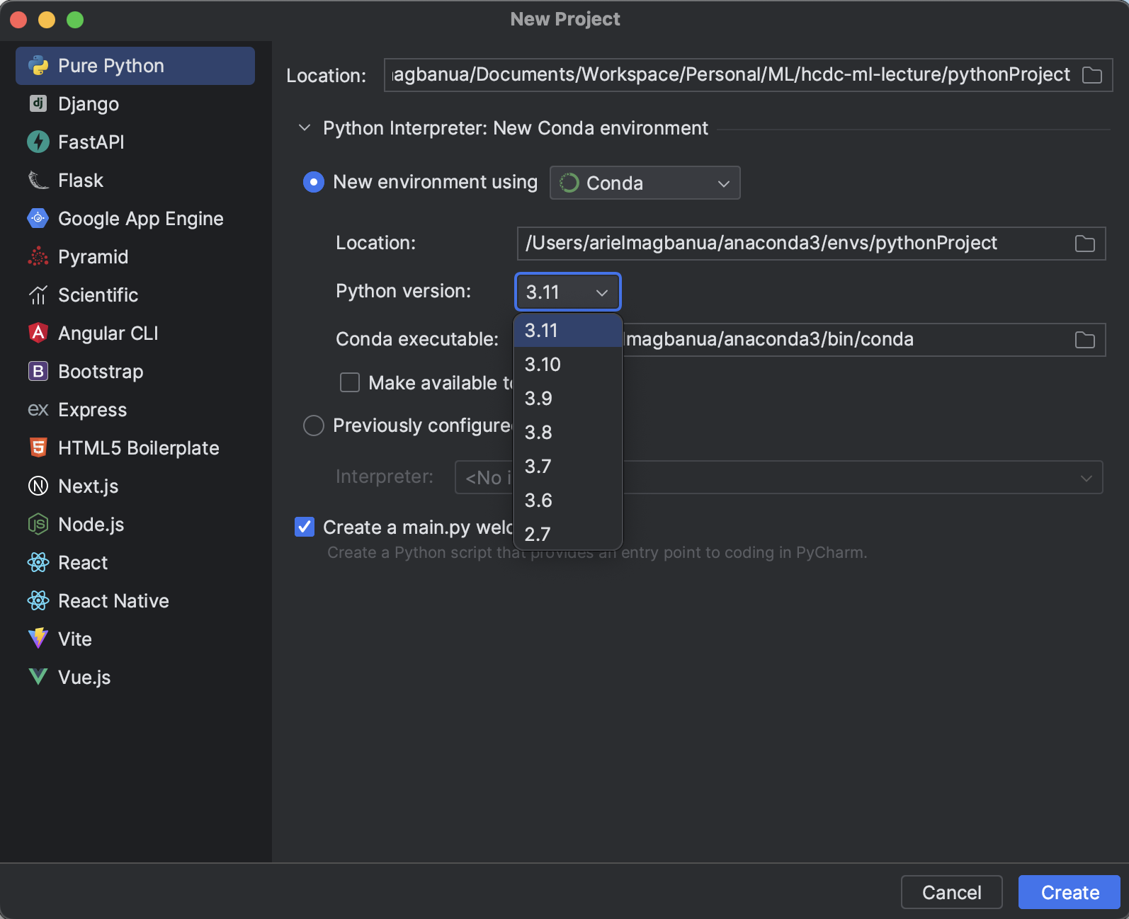
Using TensorFlow in PyCharm

Slide 6
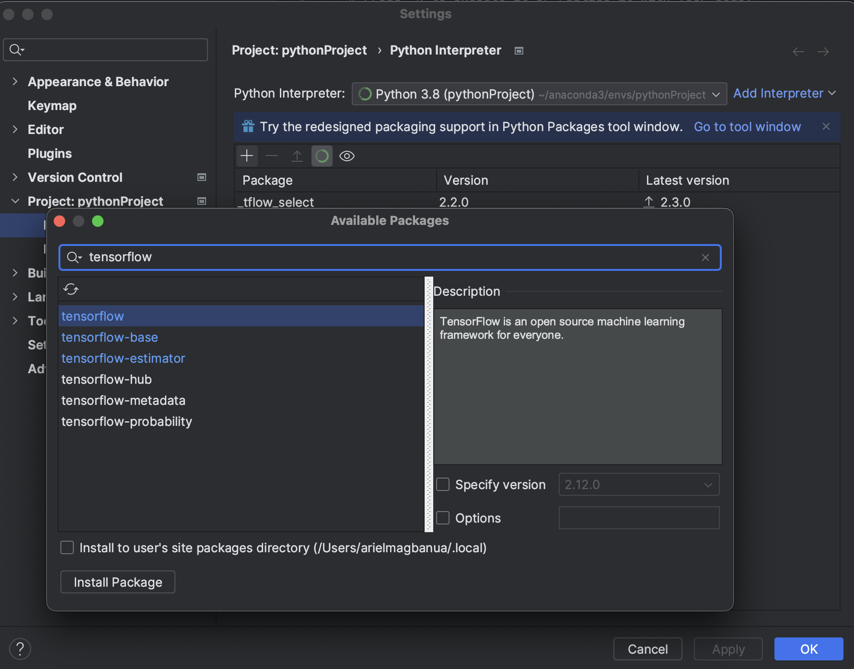
Using TensorFlow in PyCharm

Slide 7
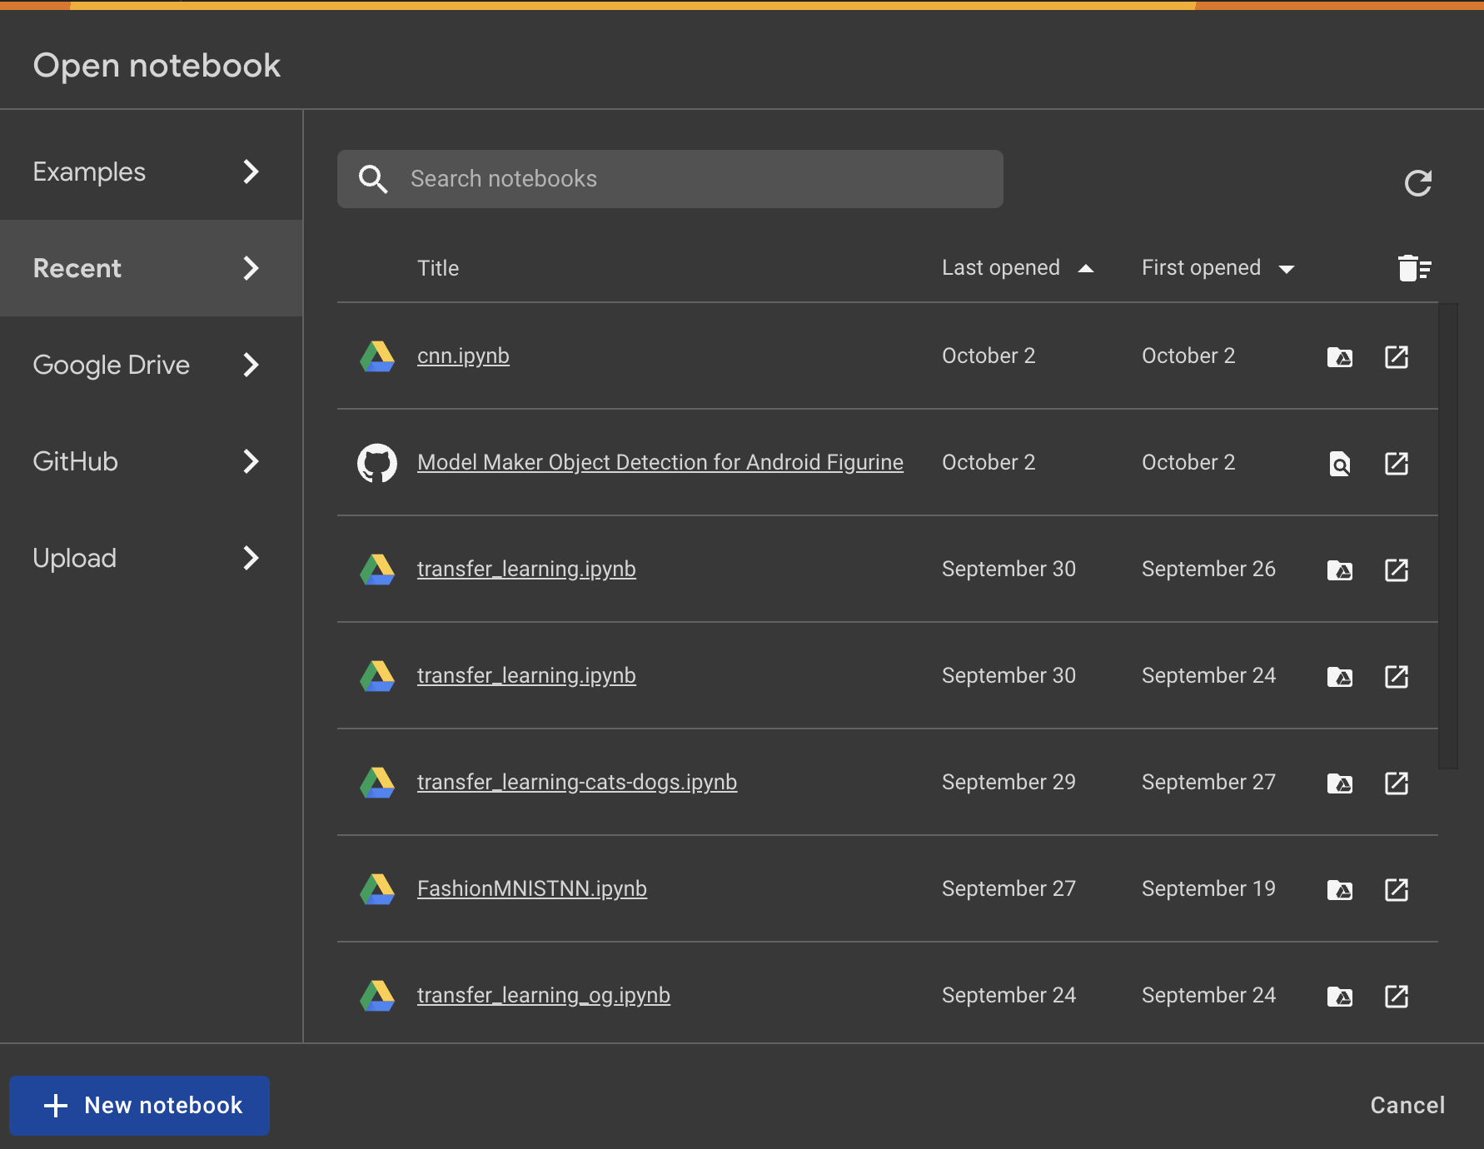
Using TensorFlow in Google Colab

